Slide 1

BANKRUPTCY PREDICTION

Slide 2

Problem Statement/OBJECTIVE
Challenge
Objective
The prediction of bankruptcy is a phenomenon of increasing interest in firms that stand to lose money because of unpaid debts.
Since computers can store huge data sets pertaining to bankruptcy, making accurate predictions from them beforehand is becoming important.
Build a model, using historical data that will determine the prediction of bankruptcy.

Slide 3
DAtASET DESCRIPTION
Data Source
Feature | Outlier_ count | Outlier_ percentage
Degree of Financial Leverage (DFL) | 1503 | 22.041355
Interest Coverage Ratio (Interest expense to E... | 1421 | 20.838833
Fixed Assets Turnover Frequency | 1418 | 20.794838
Outliers
The data was collected from the Netherlands Economic Journal for the years 1999 to 2009.
Company bankruptcy was defined based on the business regulations of the Netherlands Stock Exchange
Dataset has large number of outliers
26 features have more than 10% outliers
Data Imbalance
Dataset is highly imbalanced
~97% of observations belong to class 0.
Only 3% of observations belong to class 1
Shape of data
6.8K
94
1
Number of
observations
Number of independent
features
Target feature
(Bankruptcy)
Missing values
Duplicate values
Dataset has no missing values
Dataset has no duplicate values

Slide 4
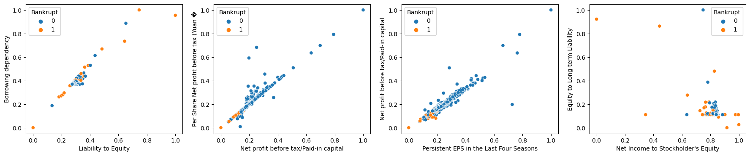
Exploratory DATA ANALYSIS
There are many non-bankrupt companies with 'Borrowing dependency' around 0.4.
Though it does not guarantee no-bankruptcy (some bankrupt companies are also present).However it seems having a lower or upper value impacts bankruptcy.
There's a visible pattern that indicates companies with low value (<0.2) of 'Per Share Net profit before tax (Yuan �'/ 'Net profit before tax/Paid-in capital'/ 'Persistent EPS in the Last Four Seasons' tend to go bankrupt.
Having 'Net Income to Stockholder's Equity' value around 0.8 may safeguard a company from bankruptcy.Though it does not guarantee it

Slide 5
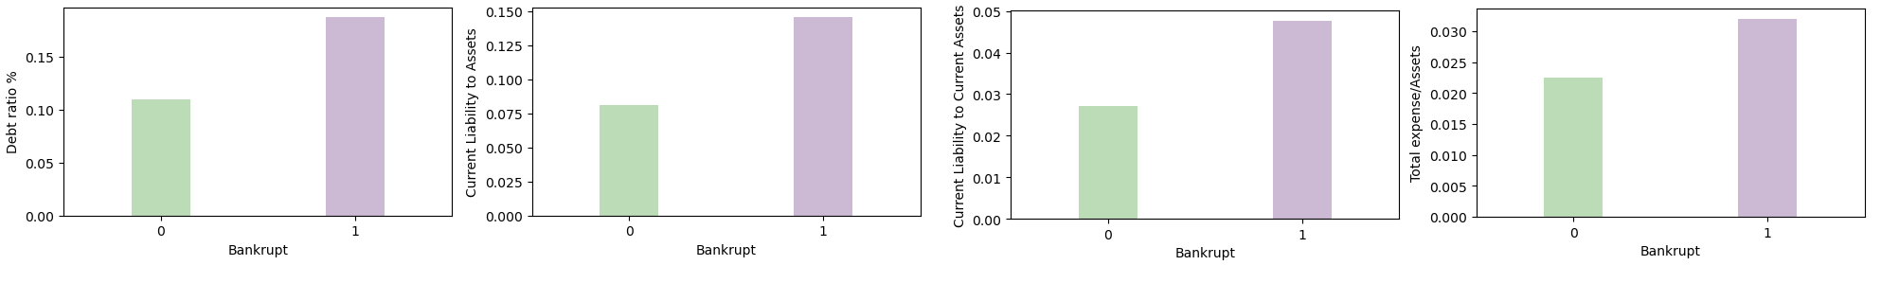
Exploratory DATA ANALYSIS
Companies with 'Debt ratio %’ > 0.187426 tend to go bankrupt.
Companies with Current Liability to Assets’ ratio > 0.145603 tend to go bankrupt.
Companies with 'Current Liability to Current Assets’ ratio > 0.047675 tend to go bankrupt.
Companies with 'Total expense/Assets ’ ratio > 0.032035 tend to go bankrupt.

Slide 6
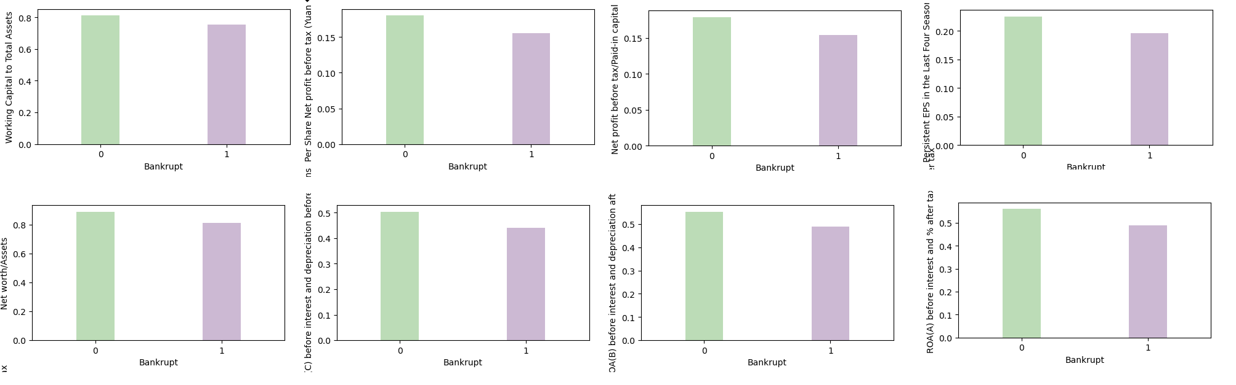
Exploratory DATA ANALYSIS
Companies with 'Working Capital to Total Assets’ < 0.752867 tend to go bankrupt.
Per Share Net profit before tax (Yuan �’ ratio < 0.155306 tend to go bankrupt.
Companies with ' Net profit before tax/Paid-in capital’ ratio < 0.154012 tend to go bankrupt.
Companies with Persistent EPS in the Last Four Seasons’ ratio < 0.195944 tend to go bankrupt.
Companies with ‘Net worth/Assets’ < 0.812574 tend to go bankrupt.
Companies with ROA(C) before interest and depreciation before interest’ ratio < 0.441330 tend to go bankrupt.
Companies with ‘ROA(B) before interest and depreciation after tax’ < 0.488597 tend to go bankrupt.
Companies with ROA(A) before interest and % after tax’ ratio < 0.490215 tend to go bankrupt.

Slide 7
EDA INSIGHTS SUMMARY
Ratio | High/Low/Equal | Median Optimum Value
Debt ratio % | Low | 0.11
current liability to assets ratio | Low | 0.08
Total expense/Assets | Low | 0.022
Net worth/Assets | High | 0.89
ROA(C) before interest and depreciation before interest | High | 0.5
ROA(B) before interest and depreciation after tax | High | 0.55
ROA(A) before interest and % after tax | High | 0.56
Net Income to Stockholder's Equity | Equal | 0.8

Slide 8
DATA PREPROCESSING & ModEL BUILDING
Data Scaling
Scaled the data
using Standard Scaler
Model Building
Logistic Regression
Random Forest
KNN
XGBoost
02
03
Train data 70% (4773)
Test data 30% (2046)
Data oversampling
Data oversampled using SMOTE method
Model Tuning
Stratified Crossvalidation
GridSearchCV for hyperparameter tuning.
Feature Selection using RFE
01
04

Slide 9
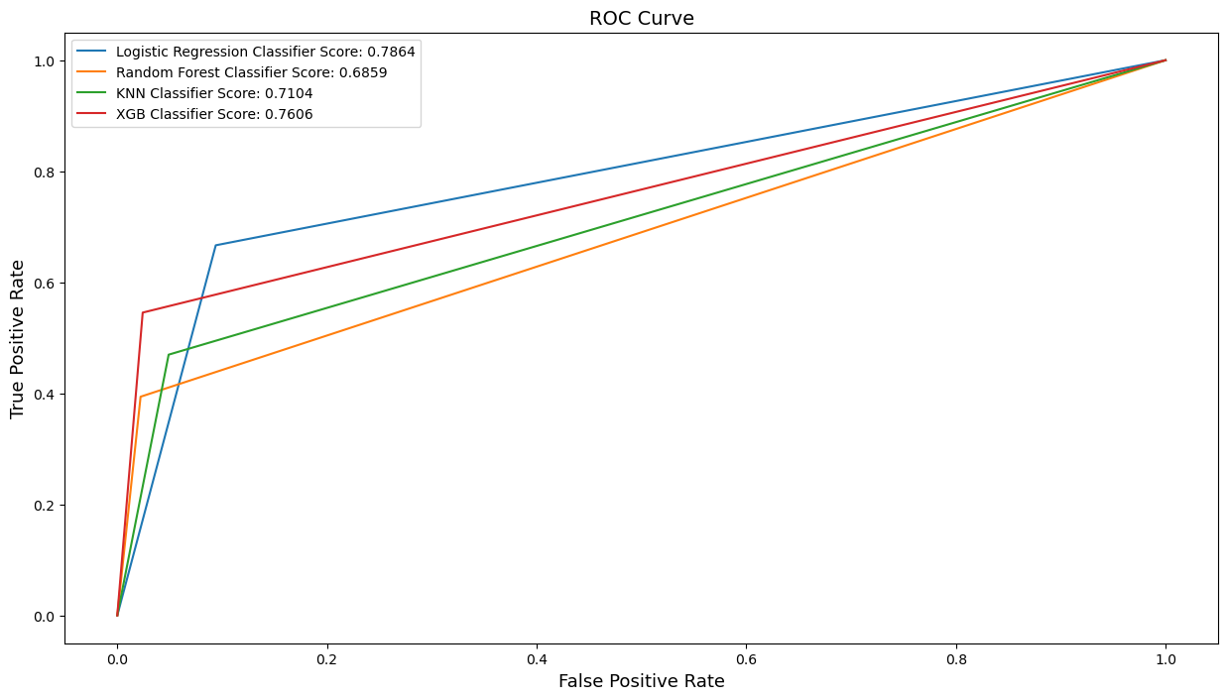
MODEl RESULTS
Algorithm | Accuracy | Precision | Recall | F1 score | ROC- AUC score
Logistic Regression | 0.898 | 0.191 | 0.667 | 0.297 | 0.786
XGBoost | 0.962 | 0.429 | 0.545 | 0.480 | 0.761
KNN | 0.935 | 0.242 | 0.470 | 0.320 | 0.710
Random Forest | 0.959 | 0.371 | 0.394 | 0.382 | 0.686
The Logistic Regression model has the highest "recall-score”
This means the model is good at predicting companies tending towards Bankruptcy.
However, this comes at a cost of low "precision-score" which means high number of false positives.
This could be acceptable in this scenario as companies identified under False Positive can become more cautious causing no harm as such.

Slide 10
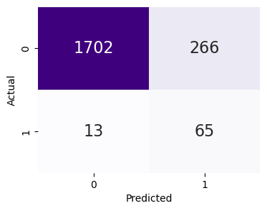
FINAL MODEL
Model results after applying feature selection
Algorithm | Accuracy | Precision | Recall | F1 score | ROC- AUC score
Logistic Regression w/o Feature Selection | 0.898 | 0.191 | 0.667 | 0.297 | 0.786
Logistic Regression with Feature Selection | 0.863 | 0.196 | 0.833 | 0.317 | 0.849
Improvement in Precision, Recall & Overall F1-score is seen in the final model after feature selection.

